Slide 1
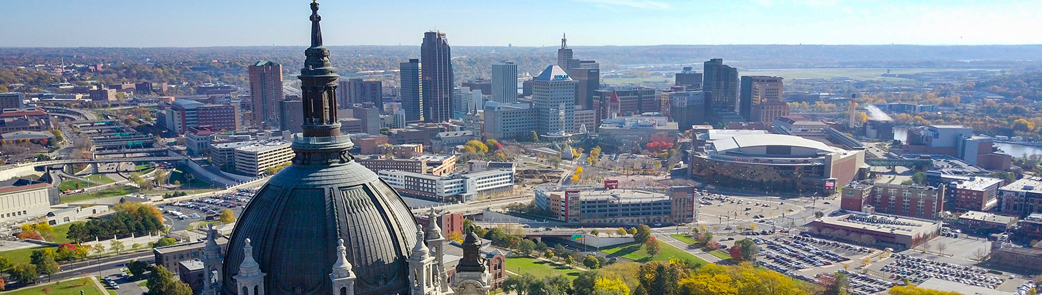
Federal Funds Coming to Minnesota
August 5, 2021

Slide 2
$8.5 Billion in ARP Funds to Support Budget Priorities

Slide 3
Minnesota’s Share of ARP Funds
Local Fiscal Recovery Fund (flexible)
$2.132 Billion
State Fiscal Recovery Fund (flexible)
$2.833 Billion
Federal Program Funds (program-specific)
$3.505 Billion

Slide 4
Local and State Fiscal Recovery Funds
Responding to the Public Health Emergency
Serving the Hardest Hit and Addressing Inequities
Addressing Negative Economic Impacts
Improving Access to Water and Broadband Infrastructure
Funds disbursed to state and locals in two payments 12 months apart. Use of funds must be decided by the end of 2024 and spent by the end of 2026.
Local Funds
State Funds

Slide 5
Local Fiscal Recovery Fund
Direct Federal Payments to Minnesota Counties: $1.11 Billion
Direct Federal Payments to 21 Large Cities: $644 Million
Pass-through Payments to Remaining Cities & Towns: $377 Million
Local governments will have separate process for individuals and organizations to access funds
Local Funds

Slide 6
Pass-Through Payments to Cities and Towns
2,613 eligible cities and towns
69% of available funds disbursed
$59,163,512 remaining
1,799 have not requested funds
Source: ARP Local Fiscal Recovery Fund Distribution Report July 27
Local Funds

Slide 7
Agreement on Local and State Fiscal Recovery Funds
State Funds
State Revenue Replacement: $1.183 Billion ($633 Million for FY 22-23 Biennium and $550 Million for FY 24-25 Biennium)
COVID-19 Immediate Response: $500 Million*
2022 Legislative Priorities: $1.150 Billion

Slide 8
How to Access State and Local Funds
Local Fiscal Recovery Funds. Local governments will develop their own processes. Reach out to your city, town, or county for details.
State Fiscal Recovery Funds. Connect with the Office of Governor Walz and Lt. Governor Flanagan or your legislators to be part of the supplemental budget process.
EXECUTIVE BRANCH
Individuals and organizations can make budget requests beginning in August. Details on request process to come.
LEGISLATIVE BRANCH
Individuals and organizations can make budget requests at any time by contacting their legislators. Visit gis.leg.mn.

Slide 9
ARP Federal Grant Funding
Supporting Working Families
Ensuring Students Catch Up On Learning
Federal Program Funds
Supporting Small Business and Driving Economic Recovery

Slide 10
Supporting Working Families
Supplemental Discretionary Child Care Development Block Grant: $202 Million
Mandatory Child Care Development Funds: $9.2 Million Increase
Child Care Stabilization Grant Funding: $324.1 Million
Women, Infants, & Children (WIC) Supplement: $8.2 Million
Low Income Home Energy Assistance Program: $167 Million
Pandemic Emergency Assistance: $14.3 Million
Older Adults (Misc.): $23.1 Million
Child Abuse Prevention: $4.4 Million
Emergency Rental Assistance: $229 Million
Homeowner Assistance Fund: $128 Million
HOME Investment Partnerships: $31 Million
Federal Program Funds

Slide 11
How to Access Support for Working Families
Childcare. Visit ApplyMN to connect with state and county services: applymn.dhs.mn.gov
Women, Infants & Children (WIC). WIC Special Supplemental Nutrition Program: health.state.mn.us/people/wic/
Low Income Energy Assistance Program (LIHEAP). Apply by September 1, 2021: mn.gov/commerce/consumers/consumer-assistance/energy-assistance/
Pandemic Emergency Assistance. Contact your local agency: mn.gov/covid19/for-minnesotans/get-help/financial.jsp
Older Adults. Contact regional Area Agency on Aging: mn.gov/board-on-aging/about-us/area-agencies/
Emergency Rental Assistance. Apply at renthelpmn.org/

Slide 12
Ensuring Students Catch Up On Learning
Elementary and Secondary School Emergency Relief: $1.3 Billion
Emergency Assistance to Nonpublic Schools: $37.7 Million
Library Services and Technology Grants: $3.2 Million
Special Education – IDEA: $52.4 Million
Homeless Children and Youth: $8.7 Million
Pandemic Electronic Benefit Transfer (P-EBT): $14.3 Million
School COVID-19 Testing: $169.9 Million
Federal Program Funds

Slide 13
How to Access Education Support
Pandemic Electronic Benefit Transfer. Learn about eligibility and apply at mn.gov/dhs/p-ebt/
Minnesota Department of Education. Learn more about the State’s plan for ARP investments and opportunities for grants at education.mn.gov/MDE/dse/health/covid19/cares/

Slide 14
Supporting Small Business and Driving Economic Recovery
State Small Business Credit Initiative: $75.3 Million
Statewide Transit Systems: $350.4 Million
Capital Projects: $179 Million
$70 million appropriated to the Office of Broadband Development
Federal Program Funds

Slide 15
How to Access Small Business and Economic Support
Minnesota Department of Employment and Economic Development. Small business assistance application guidance expected later this month.
Emergency vouchers. Learn more from the Met Council at metrocouncil.org/News-Events/Housing/Newsletters/American-Rescue-Plan-vouchers-2021.aspx

Slide 16
Public Health Funds
COVID-19 Vaccination: $52.3 Million
Address COVID-19 Health Disparities Equity Cut-out: $25.1 Million
Prevention and Control of Emerging Infectious Disease: $4.1 Million
Supplemental Vaccination: $2.3 Million
Federal Program Funds

Slide 17
Additional Help Administered by the Federal Government
Restaurant Revitalization Fund. Application period ended 7/14/2021
Shuttered Venue Operator Grant Program. Apply at www.sba.gov/funding-programs/loans/covid-19-relief-options/shuttered-venue-operators-grant
Economic Impact Payments (more than $6.3 Billion for Minnesotans). If you are eligible for a stimulus check and did not yet receive one, visit the IRS website at: www.irs.gov/coronavirus-tax-relief-and-economic-impact-payments

Slide 18
mn.gov/arp

